Slide 1
A Basic Introduction to Linux

Slide 2
So what is Linux?
It’s an operating system or OS.
It comes in many distributions.
For this training course we will be using Ubuntu.

Slide 3
Time for a quick history lesson.
Linux is an offshoot of Unix.
Developed by Bell Labs in 1969
Aim of allowing multiple users to work simultaneously.
Early 90’s Unix had become so important Linux was developed.
Notes:
Early Networking.

Slide 4
So that’s the History, what about the present?
The most ported OS across the globe.
June 2013 > 95% of the world’s 500 fastest supercomputers are using Linux.
Linux dominated the top 44 entirely.
Notes:
Google, PlayStation, Android devices are all Linux

Slide 5
Why do we use it instead of another OS?
The cost right
Visible source code
Linux promotes open sourcing and freeware of the applications written to run on it.
Notes:
Visible source code means that when an error is found you have potentially the entire community looking into it, so thousands upon thousands of people.
This means issues/faults/bugs are fixed a lot quicker than non-visible code like windows or osx

Slide 6

Any other reasons?
Another reason that has been suggested is that Linux has the better mascot. Allow me to introduce you all to ‘Tux’. - He’s a Libra, likes Sardines and long walks in the snow

Slide 7

How to access the Terminal
Now you’re in the GUI, In many ways this is very similar to the Windows or Mac OSX OS ‘s.
To access the terminal you will need to look for the below icon on the launch bar on the left.

Slide 8
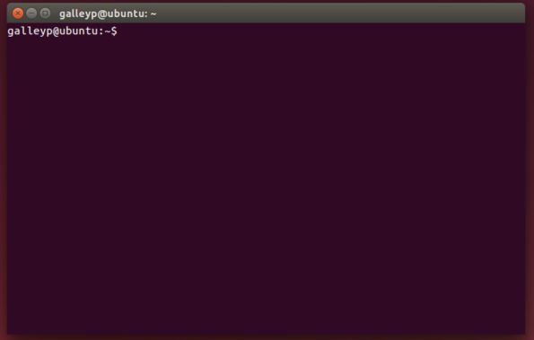
How to access the Terminal
This will result in a window like this.

Slide 9
The Basics
Basic commands, flags and getting around.
Notes:
They have the option of playing with the commands as I talk about them or waiting to use them at the exercise step.
Either way note that Linux is case sensitive

Slide 10
The Basics
So now we are in the Terminal how do we get the computer to do something?
You give the computer a command.
Start with some of the informative commands then move onto navigational commands.

Slide 11
The Basics
Command | Details
who | This will display information about who is logged on, both yourself and others.
whoami | This will display information about the current user i.e. You!
ls | ls is short hand for LiSt. It will display all the visible files within the directory that you are currently in. The files will be listed alphabetically by default but this can be altered with flags.
pwd | This will Print the Working Directory. A fancy way of asking the computer to display information about where you are and what directory you are currently working in.
apropos Keyword | This command followed by a keyword will provide you with information on commands that are related to that keyword.
man Command | This will provide you with the manual for the given command.
Notes:
Highlight the PWD command, LS command and MAN command

Slide 12
The Basics
Using these commands you can gather information about the digital world around you, using flags will give you even more control.
We will place the flags behind the ls command for demonstrative purposes

Slide 13
The Basics
Flag | Details
ls -a | LiSt All – This will list all of the files in the directory including the hidden dot files.
ls -l | LiSt Long – This will list all the files and/or subdirectories with detailed information such as file size, date modified etc.
ls -t | LiSt Time – This will sort the list into a chronological order based on modification time.
ls -tu | This list will list them chronologically based on the last access date.
ls -R | This list will include the content of subdirectories.
ls –S | LiSt Size – This list will be based on the size order.
ls –h | LiSt Human – this will make the list human readable format for example the size would be 1.0MB instead of 1004638
ls -r | LiSt Reversed – This will list the files in a reverse alphabetical order.

Slide 14
The Basics
It is possible to combine flags for instance ls –alh would display all files including hidden in the long format human readable.

Slide 15
The Basics
The commands for getting around the directories and file structures are really simple.
Inverted tree like design with the root directory at the top, the user home directory and other essential folders below that, and the general directories/subdirectories below this.
Notes:
Hierarchy system, go up and down, not side to side.

Slide 16
The Basics

Slide 17
The Basics
Command | Details
cd .. | Change Directory - to one level up the tree.
cd ~ | Change Directory - to the home directory
mkdir | Make DIRectory – this creates a new directory within the current working directory
rmdir Directory | ReMove DIRectory – This will remove the named directory, It must be within the current working directory
rm –r Directory | ReMove – the r flag on this command will along with its contents
rm –i Directory | ReMove – the i flag on this command will make it so there is user interaction, i.e. the computer will ask for confirmation
rm –ir Directory | ReMove – the combination ir will remove all files within the directory and ask for confirmation for each file within it.
mv filename new_filename | MoVe – This will move the file to a new location
cp filename new_filename | CoPy – This will make a copy of the file under the specified name.
Notes:
Highlight the space in the CD .. Command.
Advise that they might need to use shift+| or ¬ to get the ~

Slide 18
The Basics
One thing to note is that you cannot move directly between directories on the same level using the cd command alone, you have to either go up a layer using the cd .. then cd to the directory or combine the commands.
You are in dir1 and wish to get to dir2 Route 1 would use the above method of cd .. followed by a command of cd dir2 Route 2 you could use the command cd ../dir2
You can take this one step further and add in the sub directory if known that you want to go to. Cd ../dir2/subdir1

Slide 19
Tips tricks and cheats
Wildcards, auto completes, command history, quick recall…

Slide 20
Tips tricks and cheats
When searching for files or directories with similar characters or strings in their names you can use one of two wildcards * and ? ? is used to match a single character * is used to match multiple characters When combining these commands with flags you are able to perform many different functions. A prime example would be the rm flag allowing you to delete multiple files and directories with a similar name.
When typing in commands and you need to insert a file name you can increase the speed and accuracy by using the tab key to autocomplete. This works best when you are using highly unique filenames, for less unique file names it will only partially complete the file name, up to the point it no longer becomes unique
The up and down arrow keys will recall previously typed commands and the left and right keys will allow you to edit them. The history command will also allow you to see a list of previously typed commands.

Slide 21
Basic Exercises
For those of you who have not found them already there are a list of basic exercises for you to do to test out what we have gone through thus far.

Slide 22
Summary
Linux is not scary, it’s just taking you out of your comfort zone of GUI based operating systems. The Linux community is superb and there are thousands upon thousands of helpful guides, forums and users out there willing to share knowledge and help the new Linux user.

Slide 23
Thank you for listening.

